Slide 1

DISCLAIMER
The information in this presentation is provided to you by PT. AXAR Technology Raya, solely for informational purposes and does not constitute an offer to buy, sell or issue, or a solicitation of an offer to sell, buy or acquire any securities of the Company in any jurisdiction or an inducement to enter into investment activity, nor may it or any part of it form the basis of or be relied on in connection with any contract or commitment whatsoever. No representations or warranties, express or implied, are made by the Company, any underwriters, any of their respective affiliates, directors, officers, employees, advisors or representatives with respect to, and no reliance should be placed, on the accuracy, fairness or completeness of the information presented or contained in this presentation. By viewing this presentation, you agree that none of the Company, any underwriters, nor any of their respective affiliates, directors, officers, employees, advisors or representatives accepts any responsibility or liability whatsoever for any loss howsoever arising from any information presented or contained in or derived from or omitted from this presentation. The information presented or contained in this presentation was obtained from various sources, including certain third parties, and has not been independently verified, and its accuracy is not guaranteed.
This presentation does not contain all relevant information relating to the Company or its securities, particularly with respect to the risks and special considerations involved with an investment in the securities of the Company. These materials are not an offer of securities for sale. Any public offering will be made by means of a prospectus that may be obtained from the issuer and that will contain detailed information about the company and management, as well as financial statements. This presentation speaks as of its date and the information presented or contained in this presentation is subject to change without notice or update.
This presentation contains statements that constitute forward-looking statements. These statements include descriptions regarding the intent, belief or current expectations of the Company or its officers about the future. These statements can be recognized by the use of words such as “expects,” “plans,” “will,” “estimates,” “projects,” “intends,” or words of similar meaning. Such forward-looking statements are not guarantees of future performance and involve risks and uncertainties, and actual results may differ from those in the forward-looking statements as a result of various factors and assumptions, many of which are beyond the Company’s control. The Company or any of its affiliates, advisors, representatives or underwriters has no obligation and does not undertake to revise forward-looking statements to reflect future events or circumstances.
THE INFORMATION CONTAINED IN THIS DOCUMENT IS HIGHLY CONFIDENTIAL AND MAY NOT BE FORWARDED, PUBLISHED OR DISTRIBUTED, DIRECTLY OR INDIRECTLY, TO ANY OTHER PERSON (WHETHER WITHIN OR OUTSIDE YOUR ORGANIZATION/FIRM) FOR ANY PURPOSE AND MAY NOT BE REPRODUCED IN ANY MANNER WHATSOEVER. ANY FORWARDING, PUBLICATION, DISTRIBUTION OR REPRODUCTION OF THIS DOCUMENT IN WHOLE OR IN PART IS UNAUTHORIZED.
MOBILE
DEVELOPMENT
DAY 1

Slide 2
OBJECTIVES
Basic Widget
Layout
Button
Notes:
Save Time....:
The Platform will house/aggregate thousands of DIRECT SUPPLIERS. Buyer members are now abled to easily Pick whats best suitable for them.
Discover...:
Suppliers need to be a registered and verified members. There will be features such as ratings and certifications to boost further.
Grow Business:
Members akan di-empowered dengan sebuah tool digital yang yang tadinya menyerang industri, malah justru membuat mereka bisa menjadi lebih kompetitif di era digital.

Slide 3
Basic Widget
Berikut ini adalah beberapa widget dasar pada flutter :
Scaffold
AppBar
Container
Text
Row
Column
Para peserta harap membuat project flutter yang baru dengan nama project catatan_uang. Pembelajaran materi ini juga akan menjadi output akhir hasil pembelajaran selama pelatihan.
Notes:
Save Time....:
The Platform will house/aggregate thousands of DIRECT SUPPLIERS. Buyer members are now abled to easily Pick whats best suitable for them.
Discover...:
Suppliers need to be a registered and verified members. There will be features such as ratings and certifications to boost further.
Grow Business:
Members akan di-empowered dengan sebuah tool digital yang yang tadinya menyerang industri, malah justru membuat mereka bisa menjadi lebih kompetitif di era digital.

Slide 4
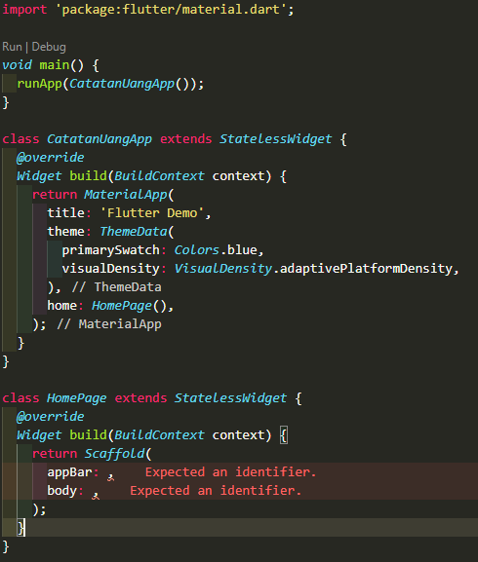
Scaffold
Scaffold merupakan kerangka dari tampilan aplikasi. Terdapat 2 attribut yang sangat penting pada scaffold yaitu : appBar dan body.
Untuk memplementasinya silahkan peserta buat default codingan seperti disamping:
Pada widget Scaffold dapat dilihat bahwa widget tersebut memiliki attribut appBar dan Body
Notes:
Save Time....:
The Platform will house/aggregate thousands of DIRECT SUPPLIERS. Buyer members are now abled to easily Pick whats best suitable for them.
Discover...:
Suppliers need to be a registered and verified members. There will be features such as ratings and certifications to boost further.
Grow Business:
Members akan di-empowered dengan sebuah tool digital yang yang tadinya menyerang industri, malah justru membuat mereka bisa menjadi lebih kompetitif di era digital.

Slide 5
AppBar
Widget AppBar merupakan widget dan value dari attribut appBar pada kelas Scaffold. Appbar juga memiliki attribut-attribut. Pada umumnya attribut yang digunakan adalah sebagai berikut :
title
centerTitle
leading
action
Notes:
Save Time....:
The Platform will house/aggregate thousands of DIRECT SUPPLIERS. Buyer members are now abled to easily Pick whats best suitable for them.
Discover...:
Suppliers need to be a registered and verified members. There will be features such as ratings and certifications to boost further.
Grow Business:
Members akan di-empowered dengan sebuah tool digital yang yang tadinya menyerang industri, malah justru membuat mereka bisa menjadi lebih kompetitif di era digital.

Slide 6
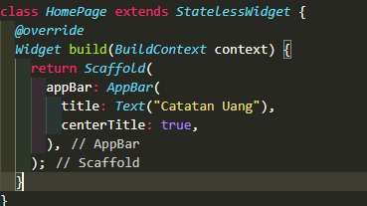
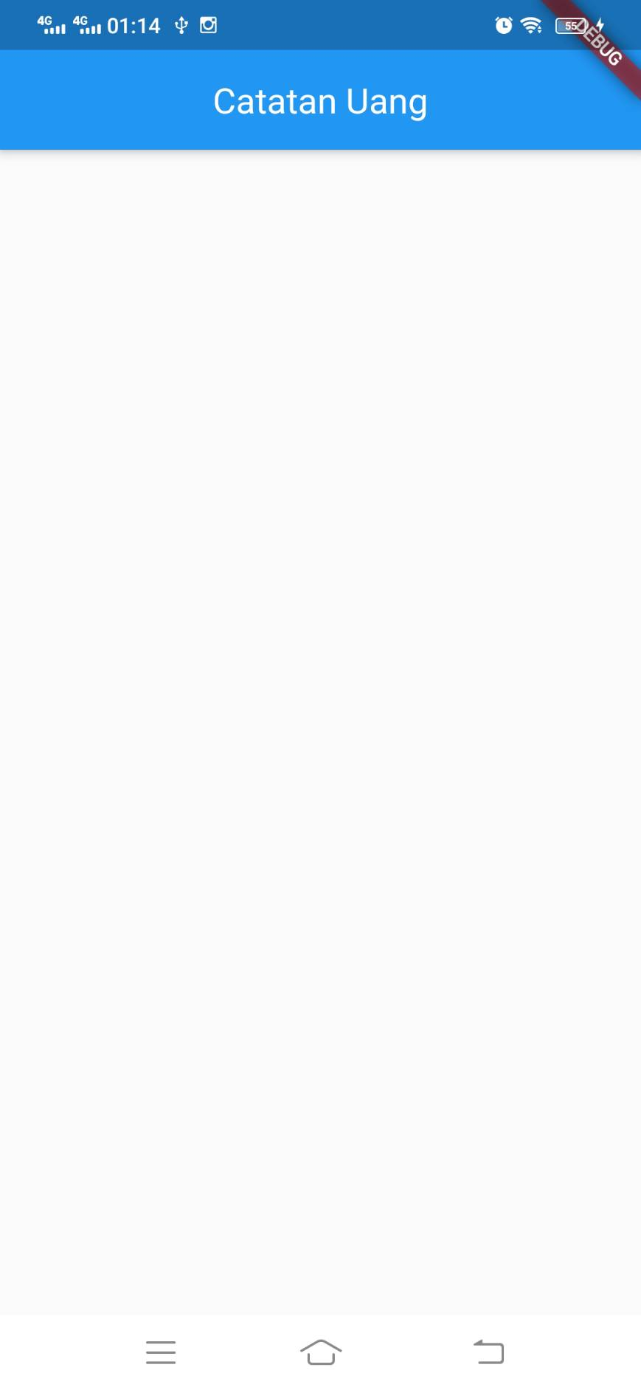
Appbar
1. title
Title merupakan sebuah Widget dan memiliki value berupa widget Text.
2. centerTitle merupakan sebuat attribut yang memiliki value boolean untuk menentukan apakan title terletak di tengah atau sesuai default
Gambar disamping adalah implementasi title dan centerTitle
Notes:
Save Time....:
The Platform will house/aggregate thousands of DIRECT SUPPLIERS. Buyer members are now abled to easily Pick whats best suitable for them.
Discover...:
Suppliers need to be a registered and verified members. There will be features such as ratings and certifications to boost further.
Grow Business:
Members akan di-empowered dengan sebuah tool digital yang yang tadinya menyerang industri, malah justru membuat mereka bisa menjadi lebih kompetitif di era digital.

Slide 7
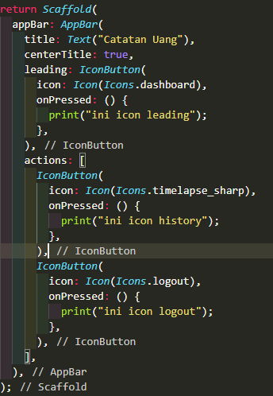
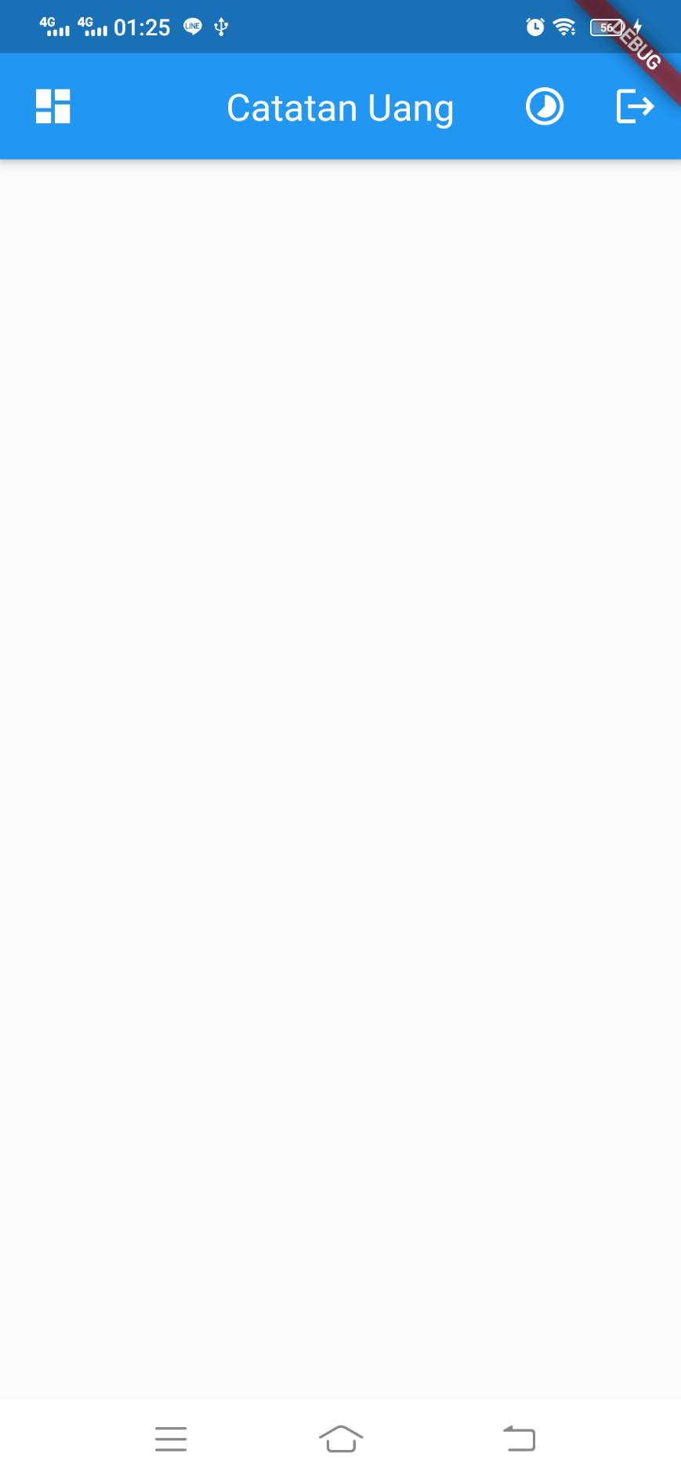
AppBar
3. Leading
leading merupakan attribut yang umumnya memiliki value berupa icon yang ditempatkan pada pojok kiri.
4. Action
action merupakan attribut yang memiliki value berupa list widget yang berupa icon atau iconButton
Notes:
Save Time....:
The Platform will house/aggregate thousands of DIRECT SUPPLIERS. Buyer members are now abled to easily Pick whats best suitable for them.
Discover...:
Suppliers need to be a registered and verified members. There will be features such as ratings and certifications to boost further.
Grow Business:
Members akan di-empowered dengan sebuah tool digital yang yang tadinya menyerang industri, malah justru membuat mereka bisa menjadi lebih kompetitif di era digital.

Slide 8
Container
Container merupakan Widget praktis yang menggabungkan widget pengecatan, pemosisian, dan ukuran umum.
berikut ini adalah attribut yang umum digunakan pada Container :
color
heigh
width
padding
margin
decoration
child
Notes:
Save Time....:
The Platform will house/aggregate thousands of DIRECT SUPPLIERS. Buyer members are now abled to easily Pick whats best suitable for them.
Discover...:
Suppliers need to be a registered and verified members. There will be features such as ratings and certifications to boost further.
Grow Business:
Members akan di-empowered dengan sebuah tool digital yang yang tadinya menyerang industri, malah justru membuat mereka bisa menjadi lebih kompetitif di era digital.

Slide 9
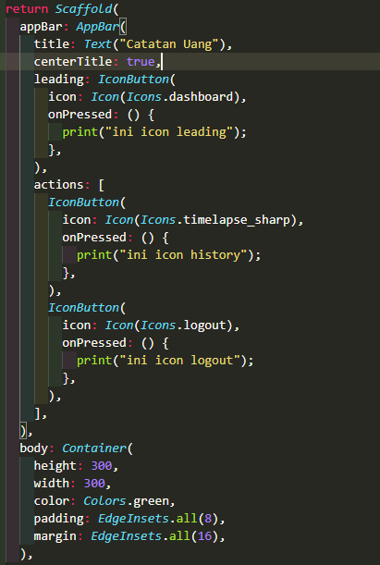
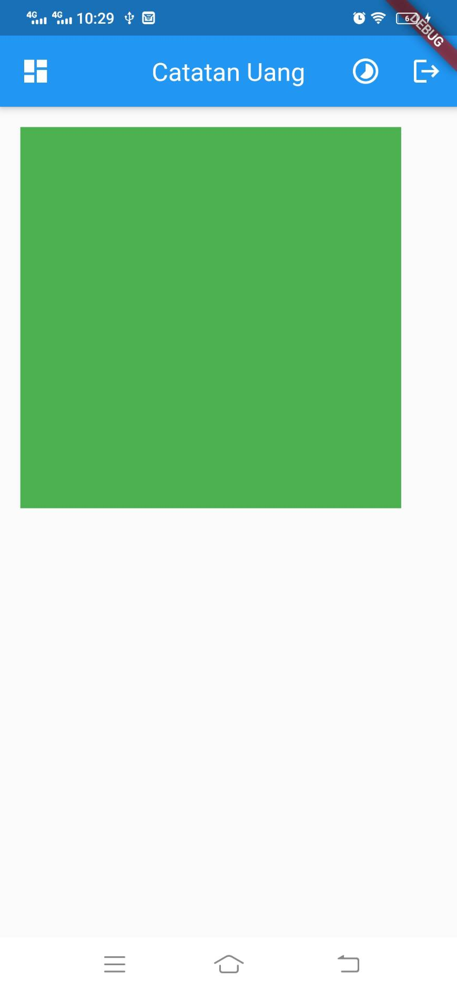
Container
1. Color berfungsi untuk memberikan warna container
2. heigh berfungsi untuk menentukan tinggi container
3. width berfungsi untuk menentukan lebar container
4. padding berfungsi untuk memberikan jarak ke dalam
5. margin berfungsi untuk meberika jarak ke luar
Pada program disamping, attribut body memiliki input yang container
Notes:
Save Time....:
The Platform will house/aggregate thousands of DIRECT SUPPLIERS. Buyer members are now abled to easily Pick whats best suitable for them.
Discover...:
Suppliers need to be a registered and verified members. There will be features such as ratings and certifications to boost further.
Grow Business:
Members akan di-empowered dengan sebuah tool digital yang yang tadinya menyerang industri, malah justru membuat mereka bisa menjadi lebih kompetitif di era digital.

Slide 10
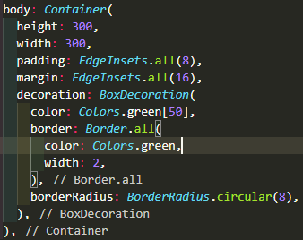
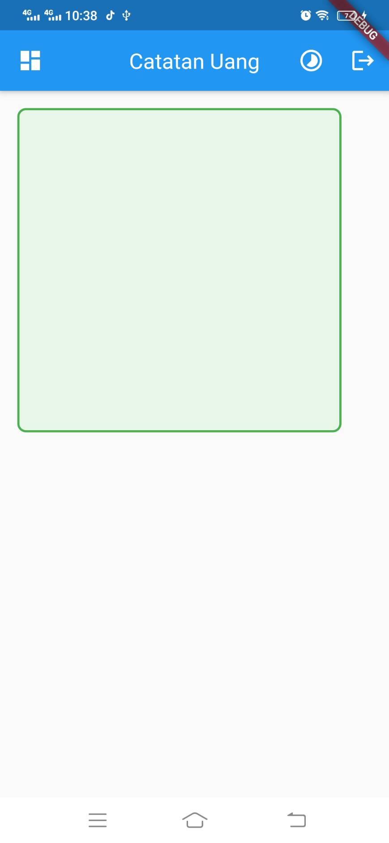
Container
5. Decoration
decoration merupakan salah satu attribut pada kelas Container yang berfungsi untuk mendesign container secara lebih detail seperti memberikan border, melengkungkan border, memberi warna dan lain-lain
Notes:
Save Time....:
The Platform will house/aggregate thousands of DIRECT SUPPLIERS. Buyer members are now abled to easily Pick whats best suitable for them.
Discover...:
Suppliers need to be a registered and verified members. There will be features such as ratings and certifications to boost further.
Grow Business:
Members akan di-empowered dengan sebuah tool digital yang yang tadinya menyerang industri, malah justru membuat mereka bisa menjadi lebih kompetitif di era digital.

Slide 11
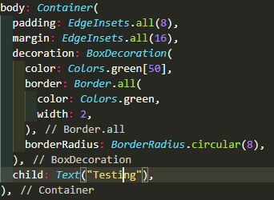
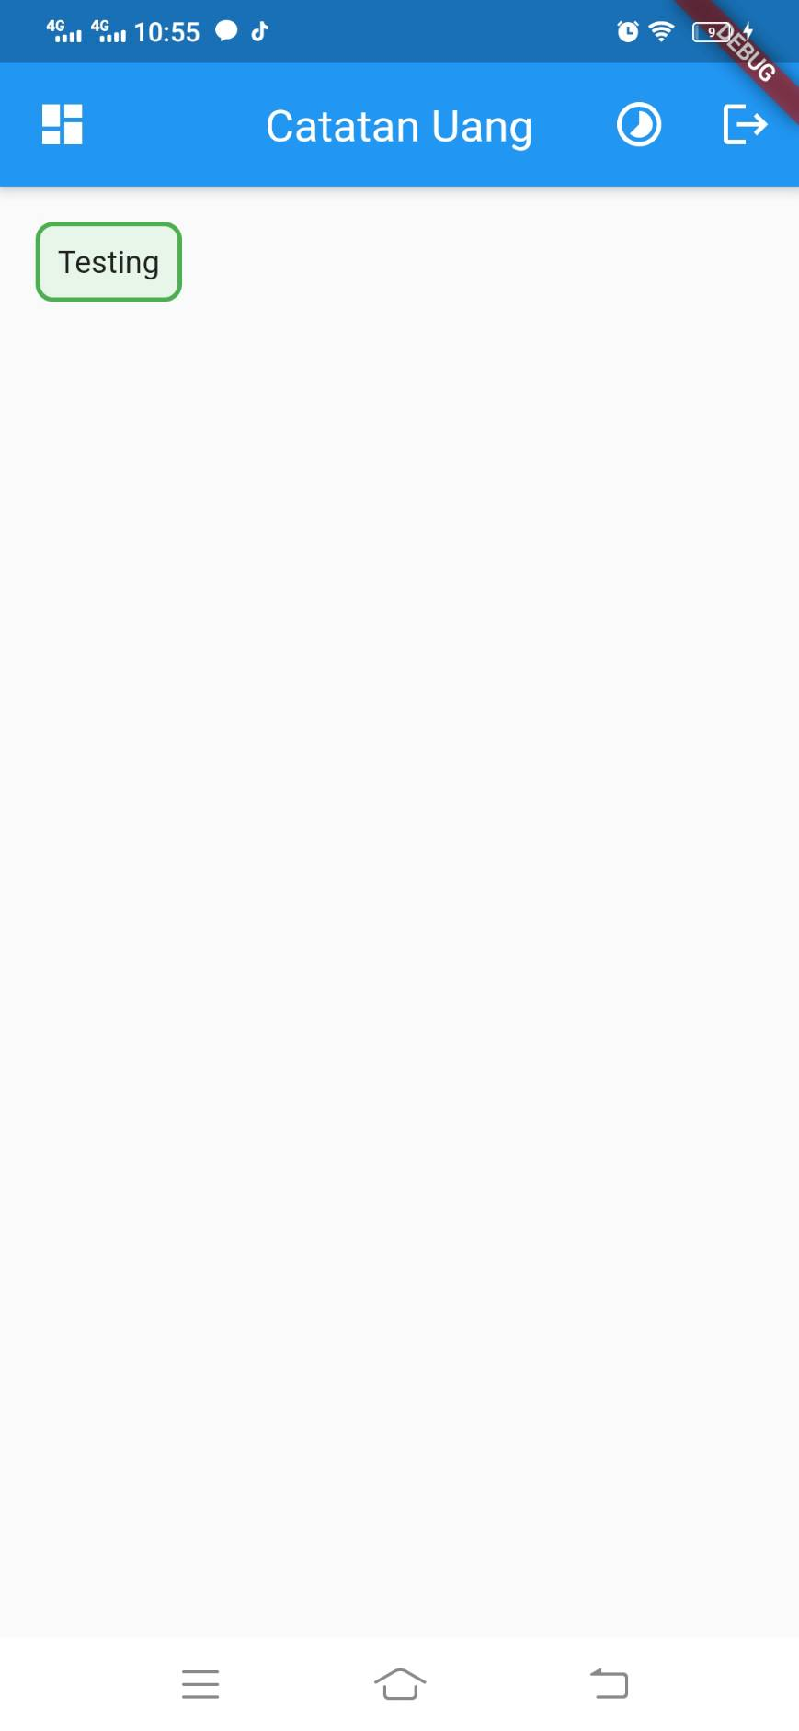
Container
6. Child
child merupakan salah attribut pada widget container untuk memasukkan sebuah widget ke dalam container tersebut.
Contoh :
program disamping container memiliki attribut child dengan value text
note : container tidak diberikan value heigh/width maka container akan mengikut ukuran widget anaknya.
Notes:
Save Time....:
The Platform will house/aggregate thousands of DIRECT SUPPLIERS. Buyer members are now abled to easily Pick whats best suitable for them.
Discover...:
Suppliers need to be a registered and verified members. There will be features such as ratings and certifications to boost further.
Grow Business:
Members akan di-empowered dengan sebuah tool digital yang yang tadinya menyerang industri, malah justru membuat mereka bisa menjadi lebih kompetitif di era digital.

Slide 12
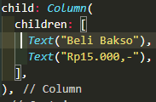
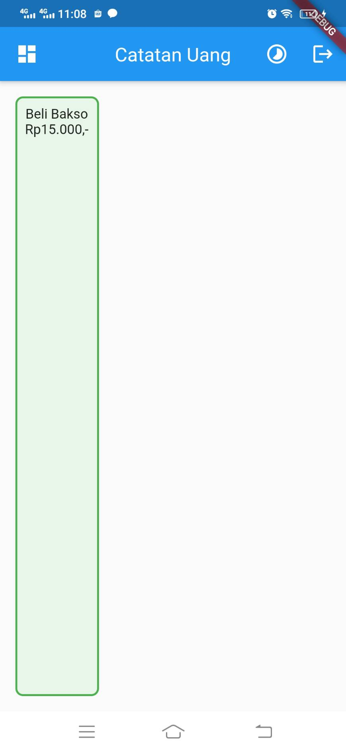
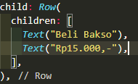
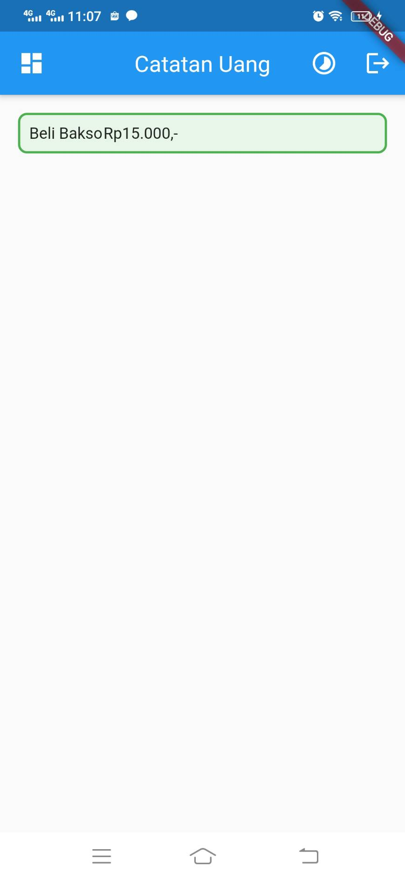
Row
Row merupakan widget yang terdiri dari list widget yang tersusun ke samping kanan. Sedangkan column merupkan widget yang dari list widget yang tersusun ke bawah.
Contoh Row contoh Column
Notes:
Save Time....:
The Platform will house/aggregate thousands of DIRECT SUPPLIERS. Buyer members are now abled to easily Pick whats best suitable for them.
Discover...:
Suppliers need to be a registered and verified members. There will be features such as ratings and certifications to boost further.
Grow Business:
Members akan di-empowered dengan sebuah tool digital yang yang tadinya menyerang industri, malah justru membuat mereka bisa menjadi lebih kompetitif di era digital.

Slide 13
Layouting
Layouting berfungsi untuk mengatur letak-letak widget yang terdapat pada layar. berikut ini adalah widget yang umumnya digunakan pada layouting :
Align
Row
Column
Notes:
Save Time....:
The Platform will house/aggregate thousands of DIRECT SUPPLIERS. Buyer members are now abled to easily Pick whats best suitable for them.
Discover...:
Suppliers need to be a registered and verified members. There will be features such as ratings and certifications to boost further.
Grow Business:
Members akan di-empowered dengan sebuah tool digital yang yang tadinya menyerang industri, malah justru membuat mereka bisa menjadi lebih kompetitif di era digital.

Slide 14
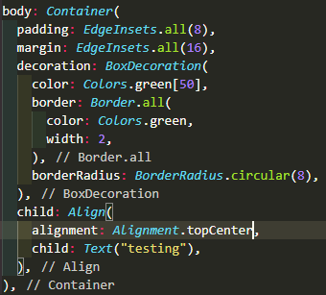
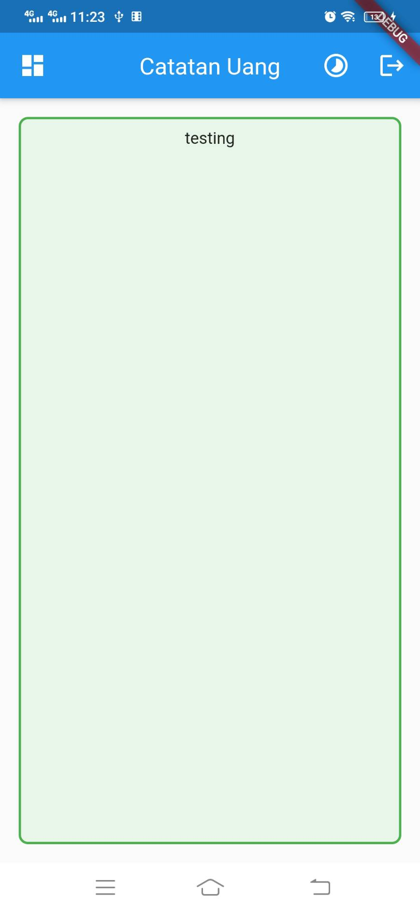
Align
Align berfungsi untuk menetukan letak widget pada layar tepatnya di atas kiri, atas tengah, atas kanan, tengah kiri, tengah, tengah kanan, bawah kiri, dst.
Contoh :
pada program disamping menggunakan katakunci topCenter yang pada Alignment sehingga tulisan testing terletak di atas tengan Container
Notes:
Save Time....:
The Platform will house/aggregate thousands of DIRECT SUPPLIERS. Buyer members are now abled to easily Pick whats best suitable for them.
Discover...:
Suppliers need to be a registered and verified members. There will be features such as ratings and certifications to boost further.
Grow Business:
Members akan di-empowered dengan sebuah tool digital yang yang tadinya menyerang industri, malah justru membuat mereka bisa menjadi lebih kompetitif di era digital.

Slide 15
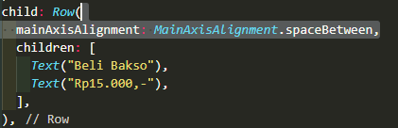
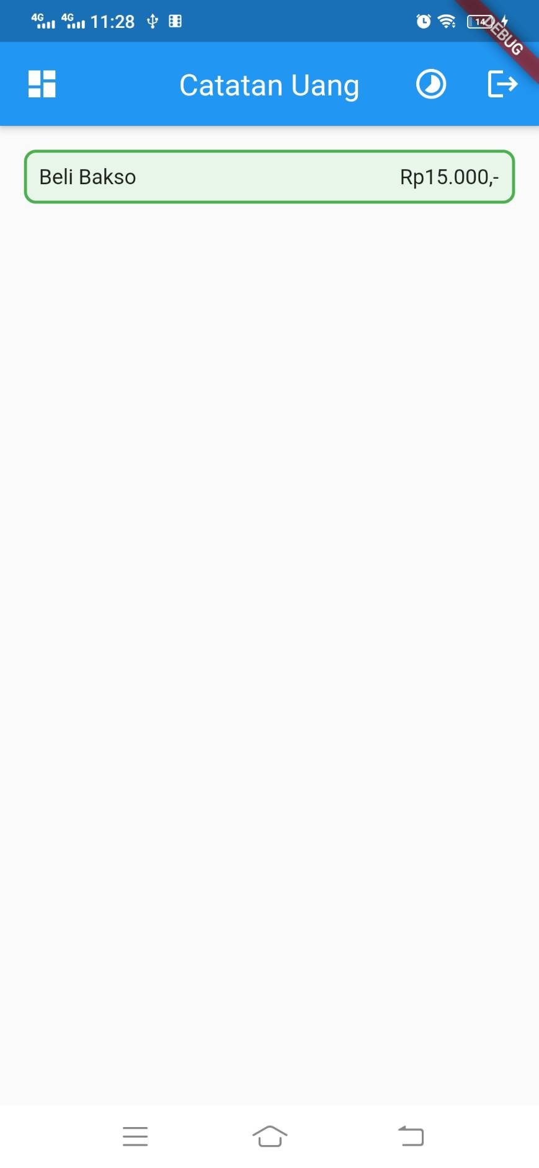
Row dan column Layouting
Row Layouting dapat diatur berdasarkan main axis nya atau cross axis nya, yang dimaksud axis dalam hal ini adalah arah dari widget tersebut
Row memiliki main axis ke samping kanan dan cross axis ke bawah
column memiliki main axis ke bawah dan cross axis ke samping kanan
Notes:
Save Time....:
The Platform will house/aggregate thousands of DIRECT SUPPLIERS. Buyer members are now abled to easily Pick whats best suitable for them.
Discover...:
Suppliers need to be a registered and verified members. There will be features such as ratings and certifications to boost further.
Grow Business:
Members akan di-empowered dengan sebuah tool digital yang yang tadinya menyerang industri, malah justru membuat mereka bisa menjadi lebih kompetitif di era digital.

Slide 16
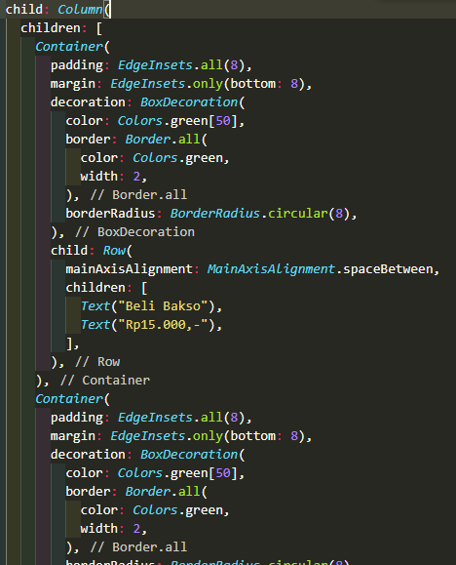
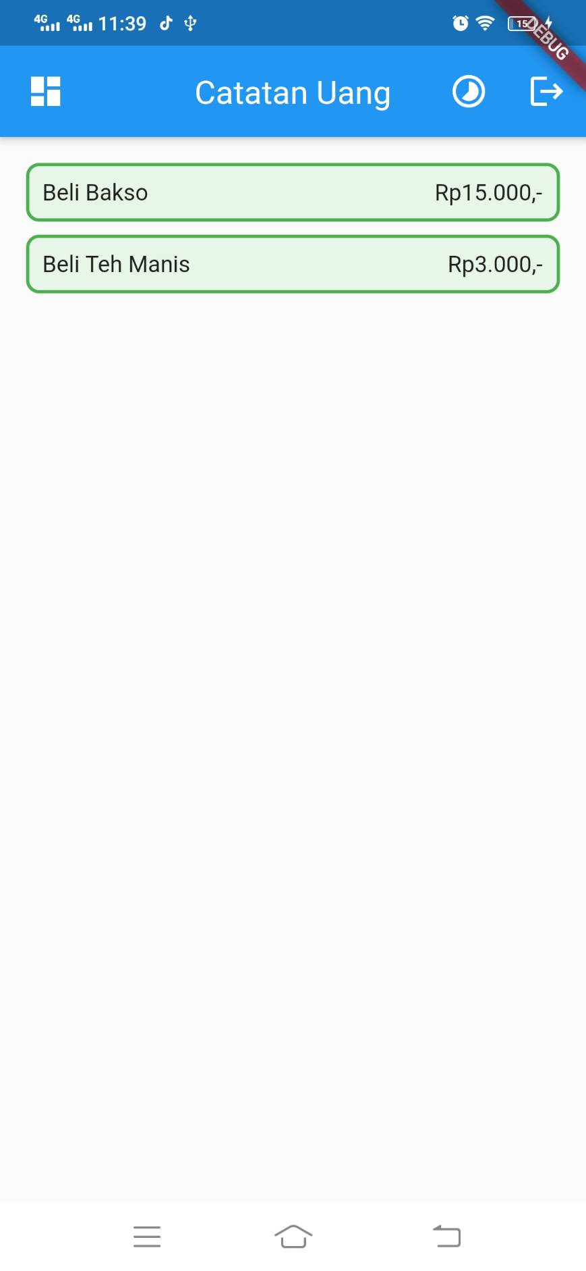
Row dan Column Layouting
Berikut ini adalah Row yang dibungkus dengan Column
Notes:
Save Time....:
The Platform will house/aggregate thousands of DIRECT SUPPLIERS. Buyer members are now abled to easily Pick whats best suitable for them.
Discover...:
Suppliers need to be a registered and verified members. There will be features such as ratings and certifications to boost further.
Grow Business:
Members akan di-empowered dengan sebuah tool digital yang yang tadinya menyerang industri, malah justru membuat mereka bisa menjadi lebih kompetitif di era digital.

Slide 17
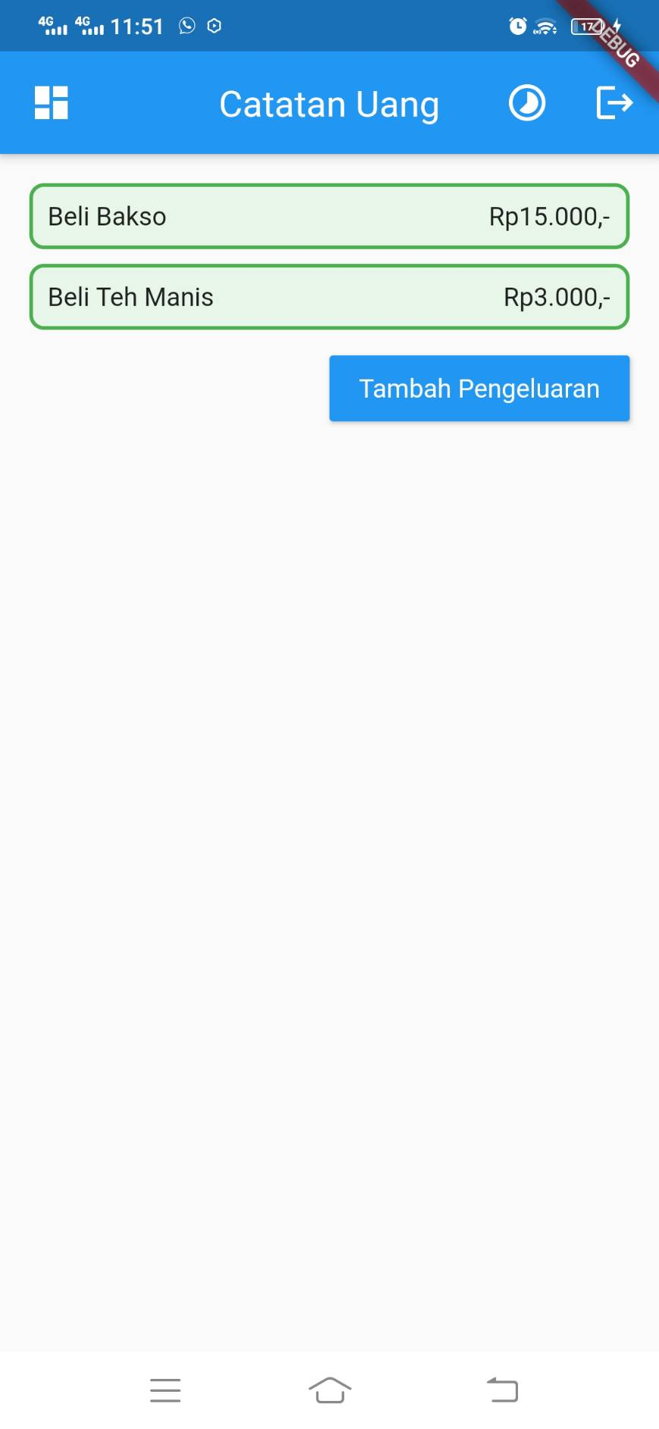
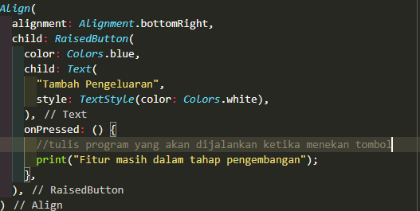
Button
Ada banyak jenis button yang terdapat pada flutter seperti icon button, material button, raised button, flat button, dll. Namun button yang paling umum digunakan pada flutter ada raisedbutton.
Notes:
Save Time....:
The Platform will house/aggregate thousands of DIRECT SUPPLIERS. Buyer members are now abled to easily Pick whats best suitable for them.
Discover...:
Suppliers need to be a registered and verified members. There will be features such as ratings and certifications to boost further.
Grow Business:
Members akan di-empowered dengan sebuah tool digital yang yang tadinya menyerang industri, malah justru membuat mereka bisa menjadi lebih kompetitif di era digital.

Slide 18
Widget
Untuk program lengkan kesuruluhan aplikasi dapat di download pada link berikut :
[isi link]
Notes:
Save Time....:
The Platform will house/aggregate thousands of DIRECT SUPPLIERS. Buyer members are now abled to easily Pick whats best suitable for them.
Discover...:
Suppliers need to be a registered and verified members. There will be features such as ratings and certifications to boost further.
Grow Business:
Members akan di-empowered dengan sebuah tool digital yang yang tadinya menyerang industri, malah justru membuat mereka bisa menjadi lebih kompetitif di era digital.

Slide 19
DISCLAIMER
The information in this presentation is provided to you by PT. AXAR Technology Raya, solely for informational purposes and does not constitute an offer to buy, sell or issue, or a solicitation of an offer to sell, buy or acquire any securities of the Company in any jurisdiction or an inducement to enter into investment activity, nor may it or any part of it form the basis of or be relied on in connection with any contract or commitment whatsoever. No representations or warranties, express or implied, are made by the Company, any underwriters, any of their respective affiliates, directors, officers, employees, advisors or representatives with respect to, and no reliance should be placed, on the accuracy, fairness or completeness of the information presented or contained in this presentation. By viewing this presentation, you agree that none of the Company, any underwriters, nor any of their respective affiliates, directors, officers, employees, advisors or representatives accepts any responsibility or liability whatsoever for any loss howsoever arising from any information presented or contained in or derived from or omitted from this presentation. The information presented or contained in this presentation was obtained from various sources, including certain third parties, and has not been independently verified, and its accuracy is not guaranteed.
This presentation does not contain all relevant information relating to the Company or its securities, particularly with respect to the risks and special considerations involved with an investment in the securities of the Company. These materials are not an offer of securities for sale. Any public offering will be made by means of a prospectus that may be obtained from the issuer and that will contain detailed information about the company and management, as well as financial statements. This presentation speaks as of its date and the information presented or contained in this presentation is subject to change without notice or update.
This presentation contains statements that constitute forward-looking statements. These statements include descriptions regarding the intent, belief or current expectations of the Company or its officers about the future. These statements can be recognized by the use of words such as “expects,” “plans,” “will,” “estimates,” “projects,” “intends,” or words of similar meaning. Such forward-looking statements are not guarantees of future performance and involve risks and uncertainties, and actual results may differ from those in the forward-looking statements as a result of various factors and assumptions, many of which are beyond the Company’s control. The Company or any of its affiliates, advisors, representatives or underwriters has no obligation and does not undertake to revise forward-looking statements to reflect future events or circumstances.
THE INFORMATION CONTAINED IN THIS DOCUMENT IS HIGHLY CONFIDENTIAL AND MAY NOT BE FORWARDED, PUBLISHED OR DISTRIBUTED, DIRECTLY OR INDIRECTLY, TO ANY OTHER PERSON (WHETHER WITHIN OR OUTSIDE YOUR ORGANIZATION/FIRM) FOR ANY PURPOSE AND MAY NOT BE REPRODUCED IN ANY MANNER WHATSOEVER. ANY FORWARDING, PUBLICATION, DISTRIBUTION OR REPRODUCTION OF THIS DOCUMENT IN WHOLE OR IN PART IS UNAUTHORIZED.
THANK YOU

